Slide 1
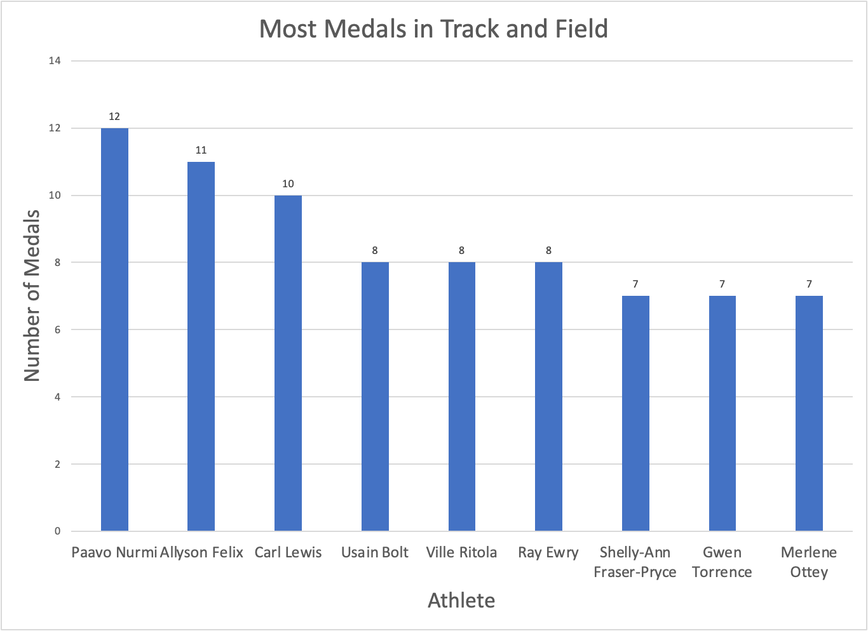
Who is the GOAT of Track and Field?
The GOAT of Track and Field is Paavo Nurmi from Finland, who competed only in the 5,000 meter race.
The sprinters with the most medals are Allyson Felix and Carl Lewis of the United States.
The sprinters with the fastest and medals are Usain Bolt and Shelly-Ann Fraser-Pryce from the dominant Jamaica.
FloJo is not the GOAT of her field, although her two records for 100m and 200m still stand.

